Slide 1
Verification of AXI to AHB Bridge
using UVM
Presented by: Sushant Gautam
Methodology: UVM Based Functional Verification
AMBA Protocol Verification | AXI → AHB

Slide 2
Project Introduction
AXI Protocol
AHB Protocol
Advanced eXtensible Interface — high-performance AMBA bus used in complex SoCs for high throughput communication.
Advanced High-performance Bus — simpler AMBA protocol ideal for peripheral and memory communication.
AXI to AHB Bridge
Verification Goal
Enables seamless communication between AXI masters and AHB slaves with proper protocol translation.
Verify correct conversion of AXI transactions into AHB transactions and validate protocol behavior across scenarios.

Slide 3
AXI Protocol Overview
AXI Key Features
AXI Channels
Separate Read & Write Channels
AW
Write Address Channel
Independent Address and Data Phases
W
Write Data Channel
Burst Transactions Support
B
Write Response Channel
Multiple Outstanding Transactions
AR
Read Address Channel
High Throughput Architecture
R
Read Data Channel

Slide 4
AHB Protocol Overview
AHB Key Features
Important Signals
Single Shared Bus Architecture
HADDR
Address Bus
Address & Data Phase Pipelining
HTRANS
Transfer Type (IDLE/NONSEQ/SEQ)
HWRITE
Transfer Direction
Burst Transfers Supported
HWDATA
Write Data Bus
Simpler Protocol vs AXI
HRDATA
Read Data Bus
AXI vs AHB
AXI is feature-rich with separate channels for high performance. AHB offers simplicity with a shared bus suitable for peripherals.
HREADY
Transfer Complete Indicator
HRESP
Transfer Response (OKAY/ERROR)

Slide 5
AXI to AHB Bridge Architecture
AXI Master
Bridge Functions
→
Address Translation
Maps AXI addresses to AHB address space
▼
⇄
Data Transfer Conversion
AXI2AHB Bridge (DUT)
Converts data widths and formats between protocols
↩
Response Conversion
Translates AHB HRESP to AXI BRESP/RRESP
▼
AHB Slave
▸▸
Burst Handling
Breaks AXI bursts into sequential AHB transfers
⚡
Error Propagation
Forwards error conditions across protocol boundary

Slide 6
Verification Objectives
Verify AXI Write Transactions
Verify AHB Response Handling
Verify AXI Read Transactions
Verify Reset Functionality
Verify Address Translation
Verify Error Conditions
Verify Data Translation
✓ Success Criteria: Expected AXI transactions must match actual AHB transactions observed at the output

Slide 7
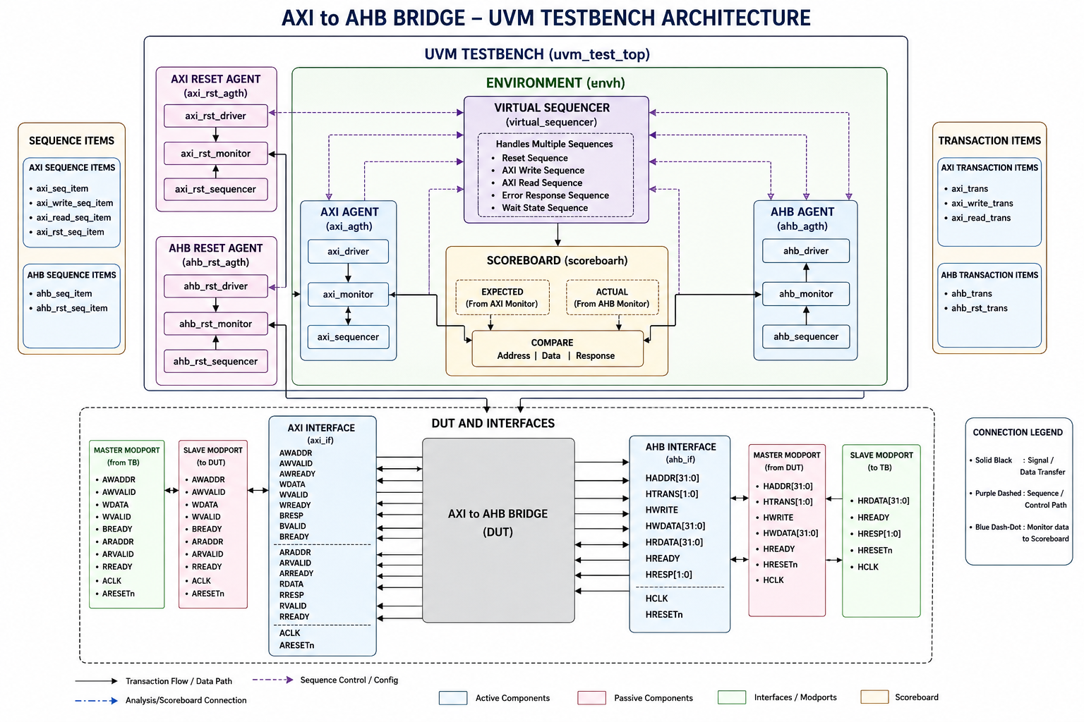
UVM Testbench Architecture

Slide 8
Agent Architectures
AXI Agent
AHB Agent
AXI Driver
AHB Driver
Receives sequence items and drives AXI signals on the interface.
Generates AHB responses: OKAY, WAIT states, and ERROR responses.
AXI Monitor
AHB Monitor
Captures AXI transactions and forwards them to the scoreboard.
Observes actual AHB transactions on the bus interface.
AXI Sequencer
AHB Sequencer
Controls transaction flow from sequences to the driver.
Orchestrates response sequences to simulate various slave behaviors.

Slide 9
Sequences & Scoreboard
Virtual Sequencer
Scoreboard
Coordinates multiple agents and provides centralized control for complex test scenarios.
AXI Monitor → Expected Tx
▼
1. Reset Sequence
AHB Monitor → Actual Tx
2. AXI Write Sequence
▼
COMPARE
3. AXI Read Sequence
✓ Address Integrity
4. Error Response Sequence
✓ Data Integrity
5. Wait State Sequence
✓ Response Integrity

Slide 10
Waveform Results – Write Flow
AXI Write → AHB Transaction Flow
Observations
1
AWVALID + AWREADY (both 1)
✅ Write Conversion
AXI Write Address Handshake –address accepted by the bridge
Successful conversion of AXI Write into AHB NONSEQ transfer verified.
2
WVALID + WREADY (both 1 )
AXI Write Data Handshake – data accepted by the bridge
📊 Protocol Timing
3
HTRANS =2 , HADDR = AWADDR
Address and data handshakes occur per protocol spec with proper phase sequencing.
Bridge initiates AHB transfer – HTRANS =2 means NONSEQ, start of valid AHB transfer
4
WDATA = HWDATA
Data translations is successful
🔄 Response Path
BRESP correctly returned to AXI master after AHB HRESP observed.
5
BRESP Returned & HRESP Generated
AXI Write Response to master & AHB Slave provides response

Slide 11
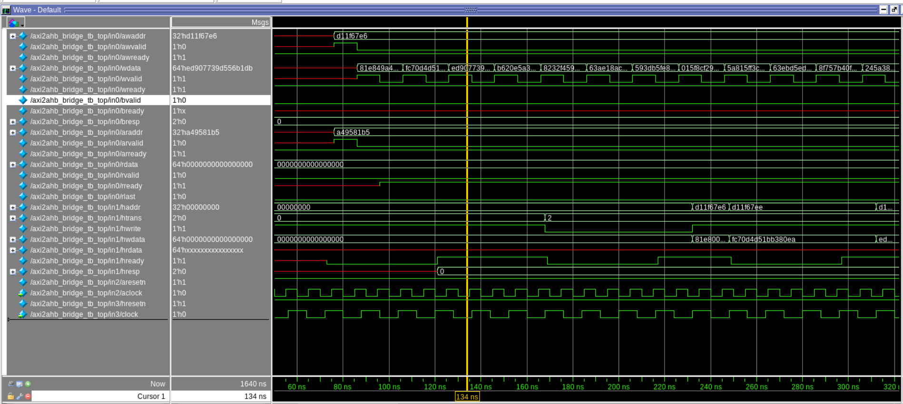
Waveform Results

Slide 12
Challenges & Learnings
⚠ Challenges Faced
✓ Key Learnings
UVM Configuration Database Issues
AXI Protocol Internals
Virtual Sequencer Connections
AHB Protocol Internals
Reset Agents Configuration
Agent Configuration Propagation
UVM Architecture & Flow
Scoreboard Synchronization
Functional Verification Flow
Debugging Protocol Timing

Slide 13
Conclusion
Successfully developed UVM Verification Environment
Verified AXI to AHB transaction conversion
Verified reset, write, read, wait-state & error scenarios
Implemented monitors, drivers, sequencers & scoreboard
Captured protocol-level waveforms validating bridge functionality
Future: Regress Functional Coverage • All possible SVA Assertions • Corner Case Testing
Thank You

